Slide 1
Using Altea LPMs Part 2
Simulating with ModelSim

Slide 2
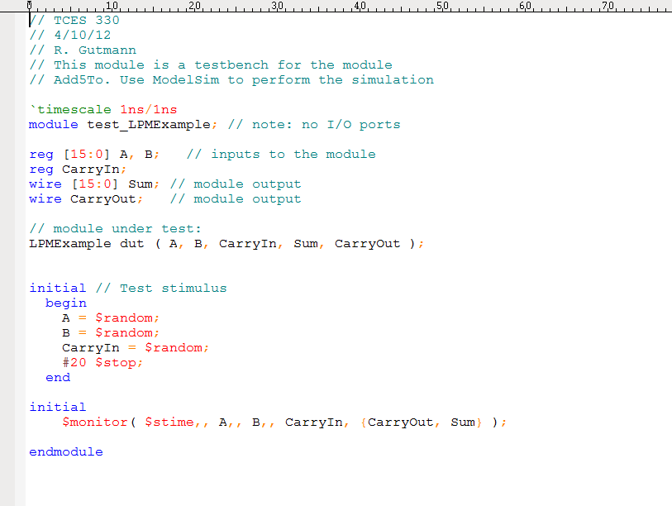
Write a Testbench

Slide 3
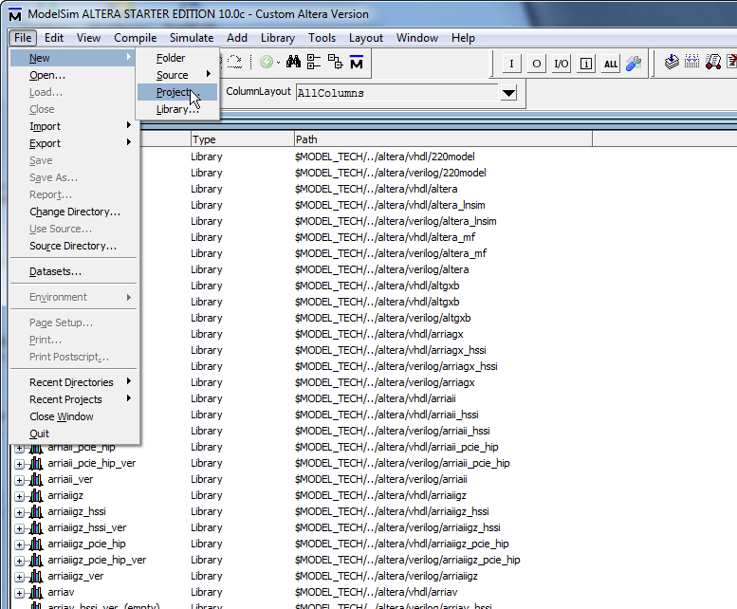
Start ModelSim
Change to project directory
Select New/Project (not Library)

Slide 4
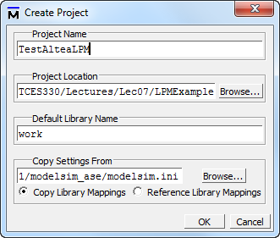
Name Your ModelSim Project
Name your project
Leave other defaults

Slide 5
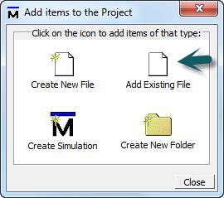
Add Verilog Files

Slide 6
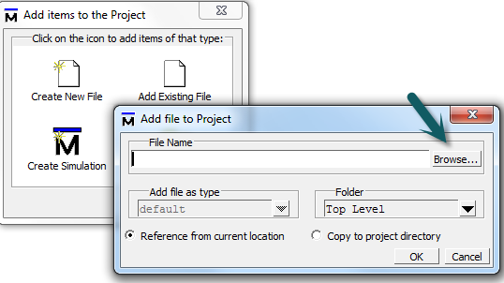
Browse for Files

Slide 7
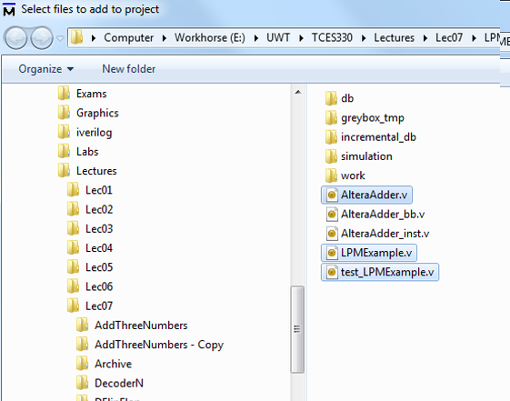
Select Files
Select the LPM file, the testbench file, and all of your project Verilog files.

Slide 8
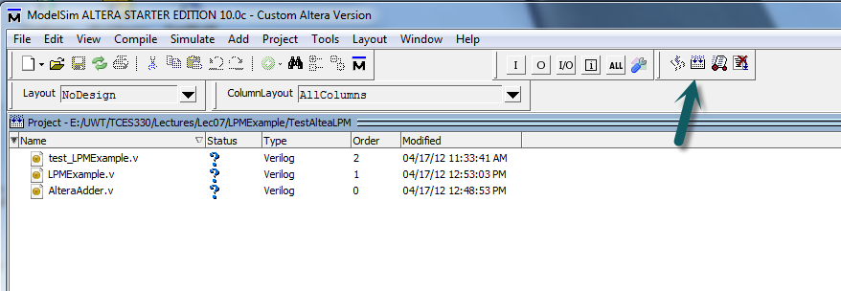
Compile All

Slide 9
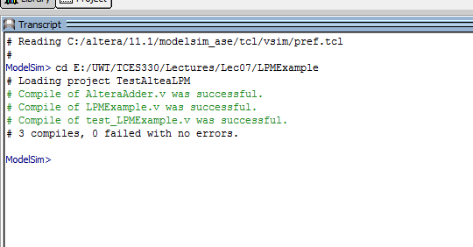
Everything Should Compile

Slide 10
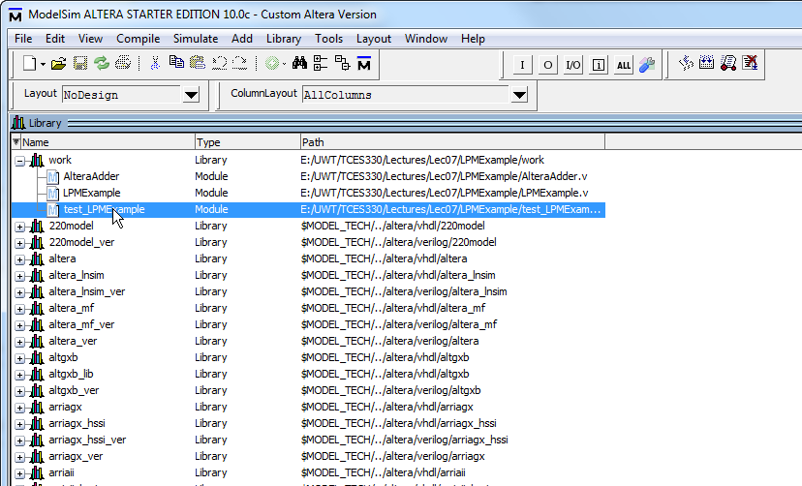
If We Double-Click Now

Slide 11
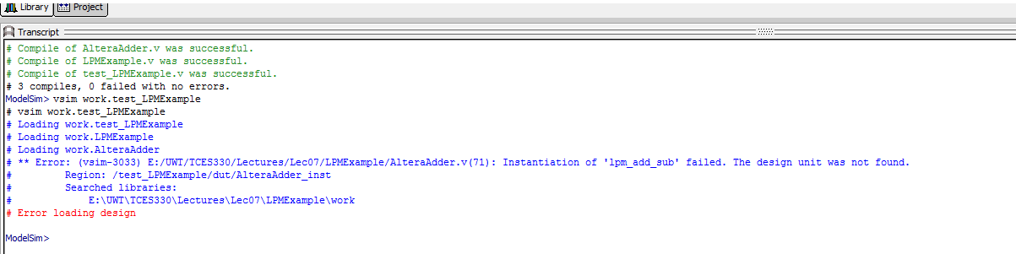
We Get Errors

Slide 12
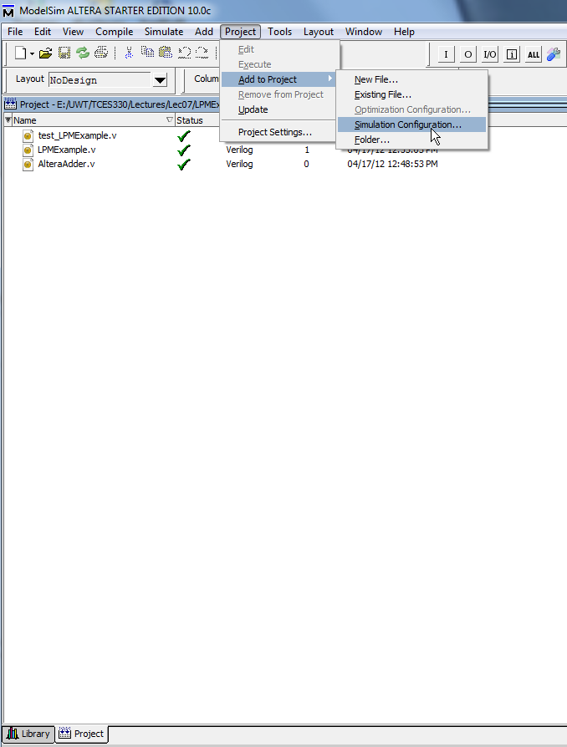
Back in the ModelSim Project
Select Project/Add to Project/Simulation Configuration

Slide 13
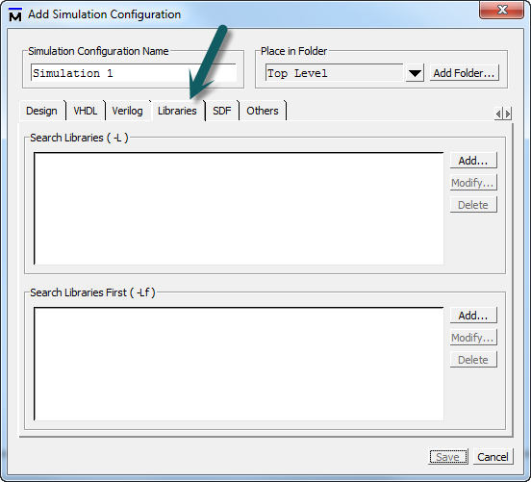
Click on Libraries Tab

Slide 14
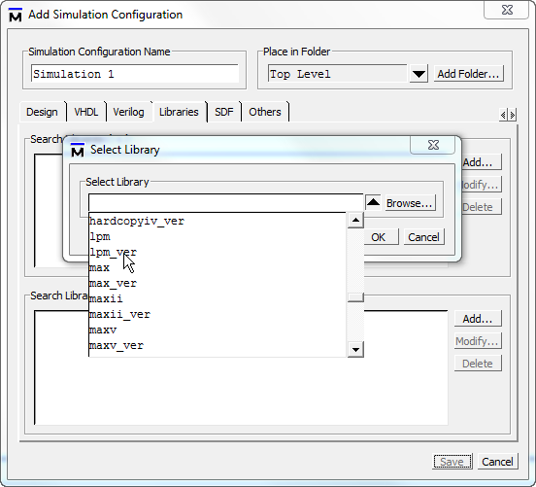
Click on Black Down Arrow
Select the library you need

Slide 15
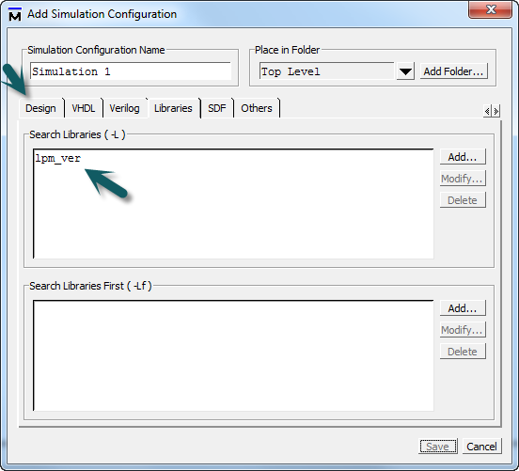
After You Select the Library
Now click the Design Tab
Library shows up here

Slide 16
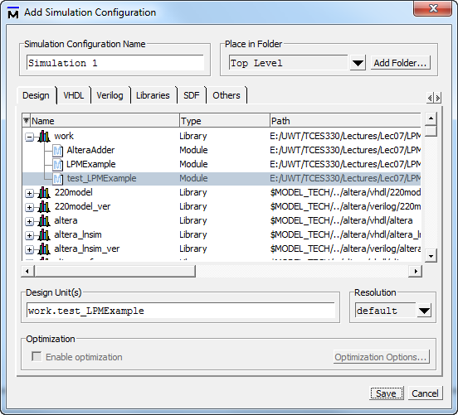
High-Light Your Testbench

Slide 17
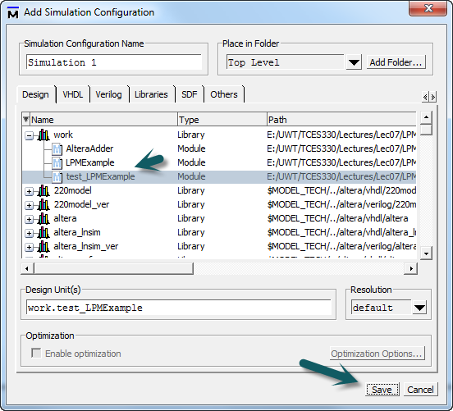
High-Light Your Testbench
Then select Save

Slide 18
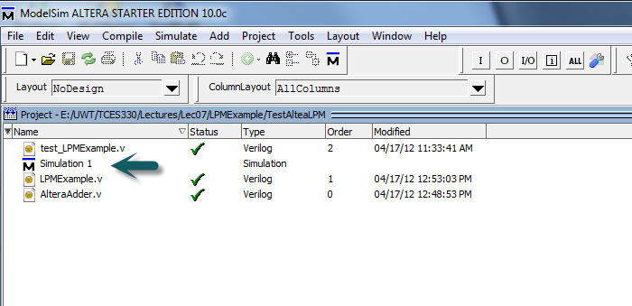
Simulation Will Be Added
Double-click the Simulation

Slide 19
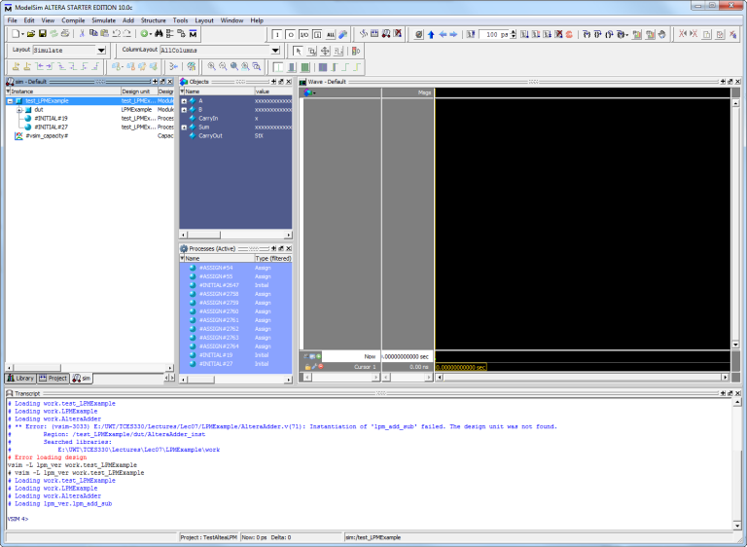
ModelSim Will Go Into Sim Mode

Slide 20
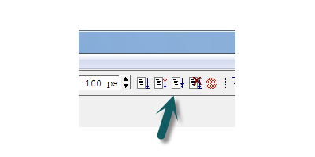
Click on Run-All Icon

Slide 21
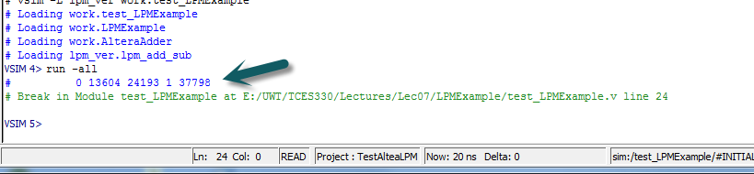
Simulation Results

